Slide 1
The Science of Team Science: Exploring Principal Investigator Leadership Style and Team Collaboration Satisfaction
Stephenie K. Kennedy
August 7, 2014

Slide 2
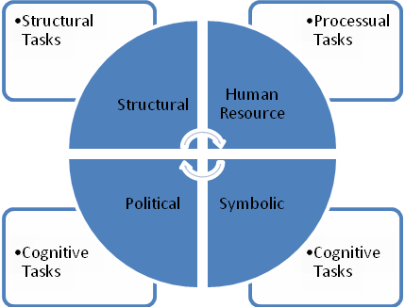
Theoretical Framework

Slide 3
Study Aims
Identify PI leadership style
Measure collaboration satisfaction
Determine if there is a difference in collaboration satisfaction based on leadership style

Slide 4
Methodology
Contacted 8 institutions
Directed to use NIH Reporter to identify funded PIs
Identified 3,043 PIs at 8 institutions
Contacted all, 203 completed
Identified
100 teams, 631members
Contacted all, 81 teams, 236 individuals completed
Need at least three members per team
38 teams,
170 individuals 7 institutions

Slide 5
Respondents
Respondent data
Nearly 70% SOM
55% female, 45% male
74% supported by more than one source
Variety of roles on team
PI data
58% male, 42% female
# Years as PI
74% more than 6 years
Size of team
53% between 6 & 10 members

Slide 6
Results
Collaboration Satisfaction
Mean Score Range

Slide 7
Results
Frame
Used all four frames
Most likely to use the human resource (M=4.25, SD=0.46) and structural (M=4.17, SD=0.46)
Difference in collaboration satisfaction by dominant frame
Dominant Frame | Mean | Standard Deviation | Tukey HSD Post-HOC
Structural (n = 42) | 4.10 | 0.74
Human Resource (n = 75) | 4.07 | 0.63 | *
Political (n = 36) | 3.71 | 0.67
Symbolic (n = 17) | 4.35 | 0.71 | *
* p < .05 significantly different from political frame

Slide 8
Results
Leadership Style
Difference in collaboration satisfaction by leadership style
 | No | Single | Paired | Multi
Number | 5 | 1 | 5 | 27
Percentage | 13.2% | 2.6% | 13.2% | 71.1%
Leadership Style | Mean | Standard Deviation | Tukey HSD Post-HOC
No (n = 20) | 3.62 | 0.51
Paired (n = 18) | 3.87 | 0.86
Multi (n = 129) | 4.12 | 0.68 | *
* p < .05 significantly different from no framed style

Slide 9
Results
Gender
Size of Team
Time as PI
Notes:
These results relate to Research Question 5.

Slide 10
Incidental Finding
Only 1 of 8 institutions could readily identify funded investigators leading interdisciplinary teams
Supports a recommendation for protocol changes at the institutional level

Slide 11
Recommendations for Practice
Improvement of PI skills in the areas of conflict resolution and meeting productivity could lead to increased satisfaction for team members
Identification of leadership style and additional training could assist PIs in communicating a vision and could aid in choice of co-investigators
Discussion of roles, responsibilities, leadership style, communication channels, and conflict resolution processes could improve team functioning

Slide 12
Further Studies
Replication of this methodology in other regions or institutions
Completion of a study that compares multi-framed leaders to others in terms of productivity
Additional studies that explore shared leadership and measure the roles team members assume
Exploration of gender influences both in terms of leadership and membership

Slide 13
